Slide 1

Data Citizen Skills Bootcamp Portfolio and Evidence
Smitha Chundakkad

Slide 2
Introduction
Smitha Chundakkad
My name is Smitha Chundakkad and my motivation for doing the bootcamp was to attain the skills and knowledge to get into a data role and further my career as a Data analyst.
I work as a Research Technician in a Scientific Research Institute and through my work I gained an understanding of how valuable data is for an organisation. I had a basic understanding of excel but had no visualisation knowledge. I realised that expanding my data analysis skills would not only add value to the work I do for my organisation, but also support my further career development.
By doing the programme, I found working with data is challenging and enjoyable at the same time. I learned how to source and combine data and how to analyse it using various tools. I also learned to use functions and formulas, such as VLOOKUP, statistical measures and Macros. I am able to use pivot tables, pivot charts as well as various visualisation tools in Power BI.
Within my portfolio, I am able to demonstrate some of the key assignments I completed on the programme to show my new level of competency and understanding.
With my newly gained knowledge, I would be able to move up to a more data orientated role in the Scientific Research Industry and contribute to the Research field.

Slide 3
How does data add value to organisations?
Smitha Chundakkad
Data adds value to organisations by providing useful information. It has become a valuable asset to businesses over the past few decades. Advancement in technologies mean that a vast amount of data is available for organisations to understand the customers and trends to help them make decisions.
Analysis of collected data can provide improved insights into performances and help in determining the cause of problems. Data allows organisations to visualise what is happening in different locations, departments and systems.
Business activities could be improved by using data. Data helps them to optimise processes to improve user experience and better customer interactions. Data analysis is valuable as it helps businesses to create better products, reduce wastage and reduce costs.
By analysing data and turning it into wisdom, organisations can increase profitability and gain competitive advantage. Having worked in the research industry I can see that how good quality data can help improve designing future projects, by looking at previous patterns.

Slide 4

Task 1 - Data sourcing and extraction
Smitha Chundakkad
Most profitable English movies by Genre
To answer the question I extracted two data sets –
1. Most profitable movies based on world wide gross
https://www.the-numbers.com/movie/budgets
2. List of movies with genre they belong to
https://datasets.imdbws.com/

Slide 5
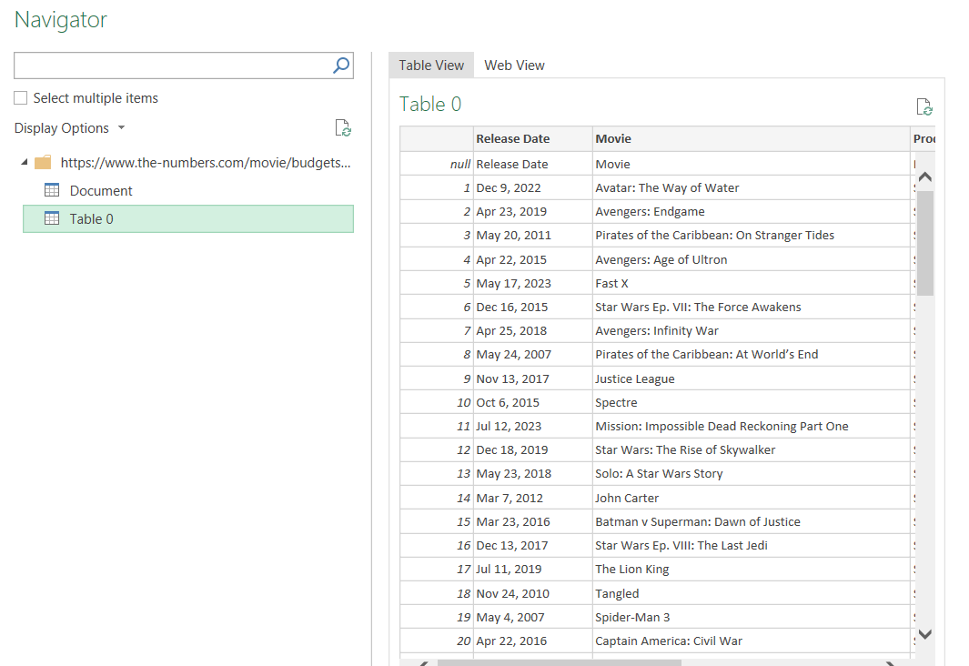
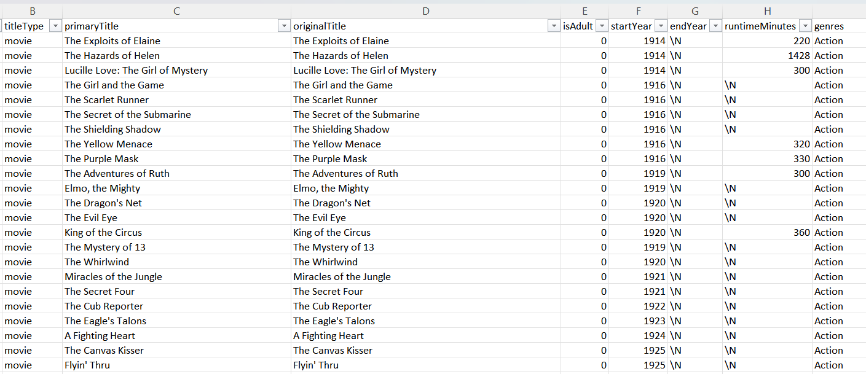
Task 1 - Data sourcing and extraction
Smitha Chundakkad
Extracting data using Power query
Dataset 1
Dataset 2

Slide 6
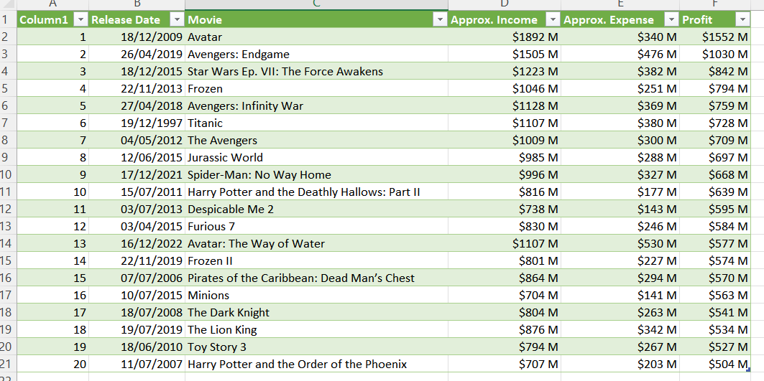
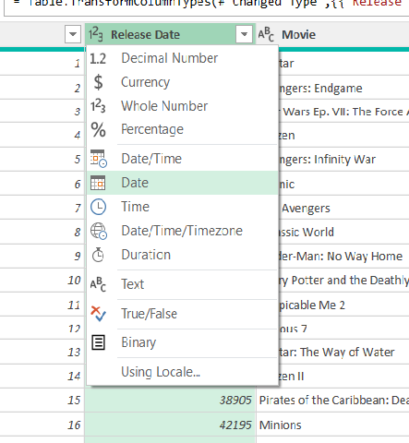
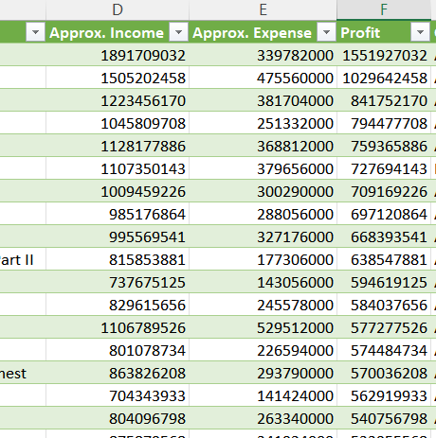
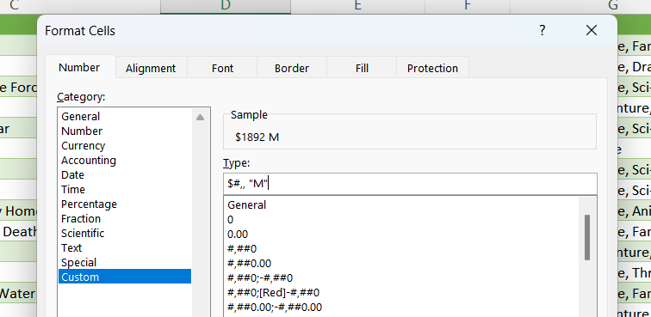
Task 1 - Data sourcing and extraction
Smitha Chundakkad
Clean Data
I corrected the date format from Whole number to Date in Power Query.
I used the Number formatting tools to convert the currency to Millions.

Slide 7
Task 1 - Data sourcing and extraction
Smitha Chundakkad
I did a simple analysis using the first dataset.
The chart shows the extend of profit the top grossing movies earned in relation to the expenses incurred during its production.

Slide 8
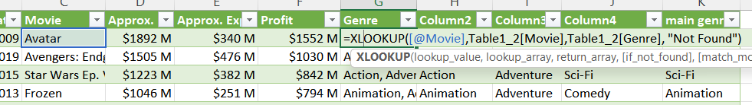
Task 1 - Data combining
Smitha Chundakkad
Next, to find out which genres made the most profit, I had to combine both datasets.
I used XLOOKUP to find the corresponding genres from the dataset from IMDb.
Then I used a pivot table to summarise the data before plotting in a bar chart.

Slide 9
Task 1 - Data combining
Smitha Chundakkad
Result
The analysis of the available data on the top 20 movies led to the following key findings:
Movies in the Animation, Adventure and Comedy genre combination did better than any other genre combinations, probably because that genre attracts audience from all age groups.
Overall, Adventure and Action movies were very popular. This could be because those kind of movies are better experienced in cinemas than at home.
Conclusion
The use of XLOOKUP helped me to combine multiple tables from different sources.
Forming pivot tables were very handy in summarising and finding relationships between data.
Pivot charts helped to make the visualisations easy so that we can see the patterns and trends within the data.

Slide 10
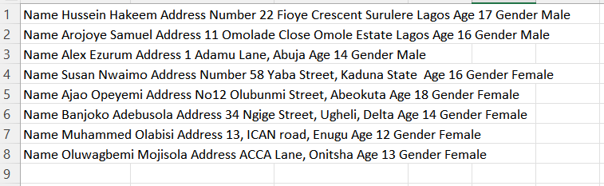
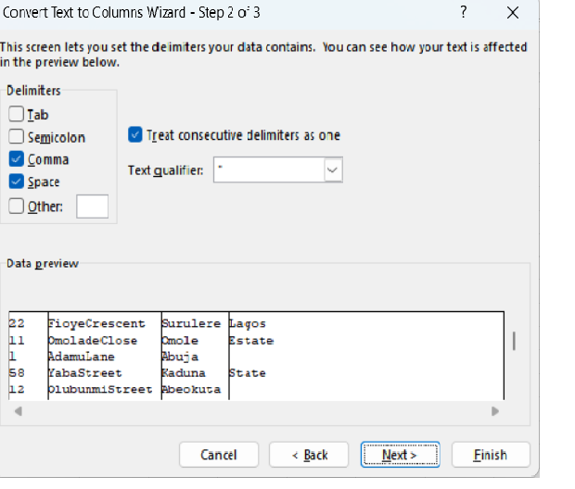
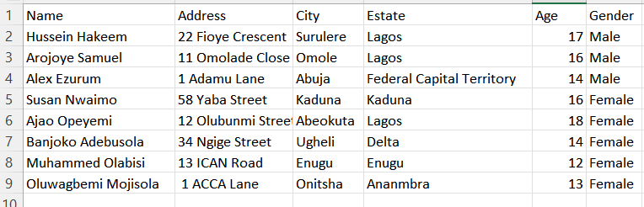
Task 2 - Data Cleaning
Smitha Chundakkad
Having clean data is critical to data analysis. Here we have a fake dataset provided by Cambridge Spark, which is hard to read and difficult to analyse.
Dataset 1
Objective
To clean incomplete, incorrect, inaccurate or irrelevant parts of the data, so that the analysis is reliable.
Dirty data
Action
I used the Text to column feature to organise the data in to columns, which made it easily readable.
I then used concatenate function to get the full name together in a cell and Flash Fill to fill the column.
Next, I separated the addresses into columns using text to columns and did a web search for the correct Estates, so that the data is complete. Now it is ready for analysis.
Clean data

Slide 11
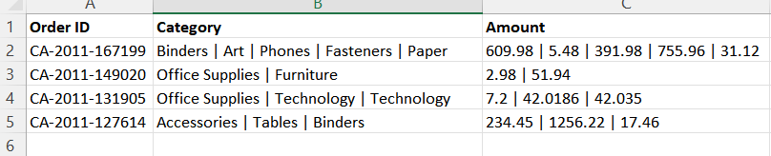
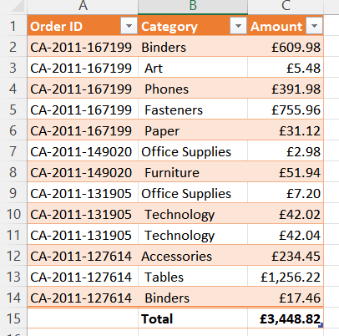
Task 2 - Data Cleaning
Smitha Chundakkad
Dataset 2
This is another fake dirty dataset showing the amount spent on office supplies.
Objective
This data needs to be cleaned and organised in order to understand how much the company is spending on each office item and to fix a budget.
Action
Using the ‘Text to column’ function and ‘bar’ as the delimiter, I moved the data in the Category and Amount column to separate columns and then transposed it.
Then I copied the Order ID to the corresponding Category. Next, I formatted the Amount into Currency and added a cell for Total using ‘AutoSum’.
I transformed the data into a table using shortcut keys, Ctrl+T, so that if any new data is added it automatically get added to the table.

Slide 12
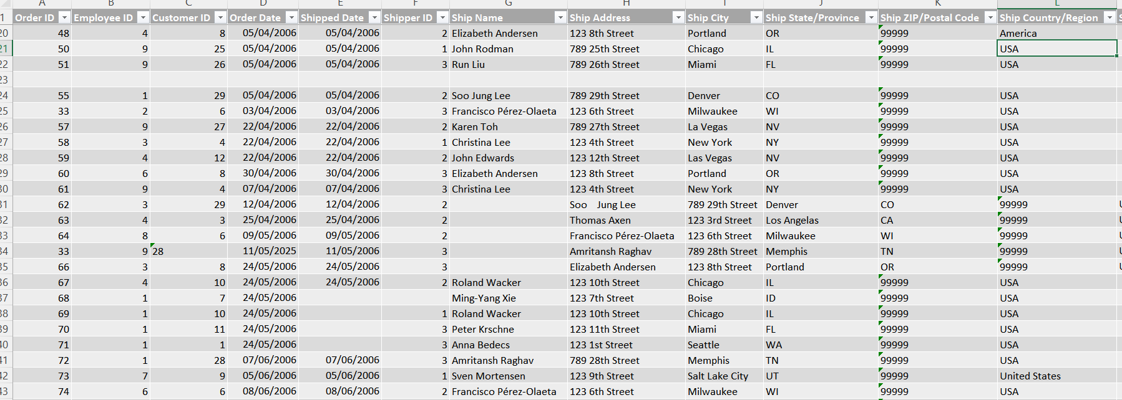
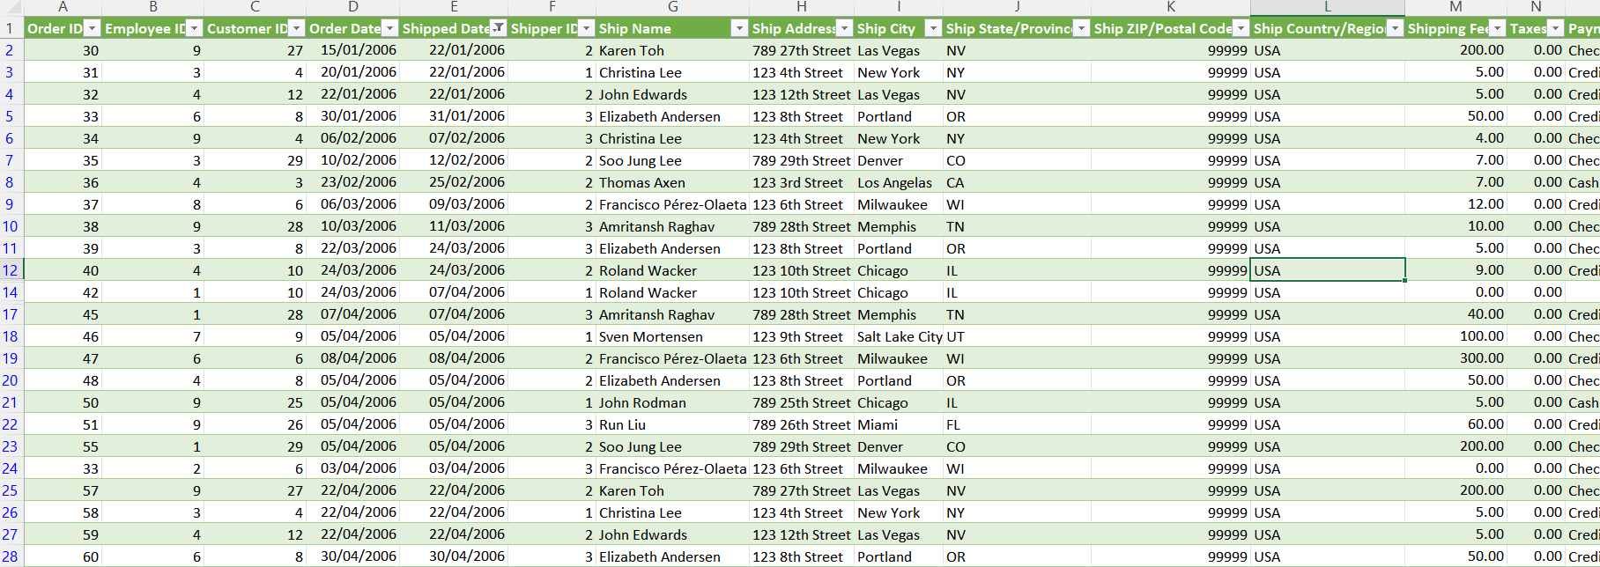
Task 2 - Data Cleaning
Smitha Chundakkad
Dataset 3
This dataset provided by Cambridge Spark contains many inconsistencies, such as missing values, misaligned data, wrong formatting, empty rows and incomplete data.
Dirty data
Objective
This data needs to be cleaned and organised in order to understand how much they are spending on each item and to fix a budget.
Action
First, I removed any duplicate values using the remove duplicate function.
Next, using the Find& Select option I highlighted all the blank cells and rows and removed them if necessary.
I moved the displaced entries to the right columns, changed all different forms of USA to a single form using the filter option.
I converted the dates and currency to the proper formats using formatting cells function and
I deleted any columns with irrelevant data.
Then I converted the data into a table for easy usage.
Clean Data

Slide 13
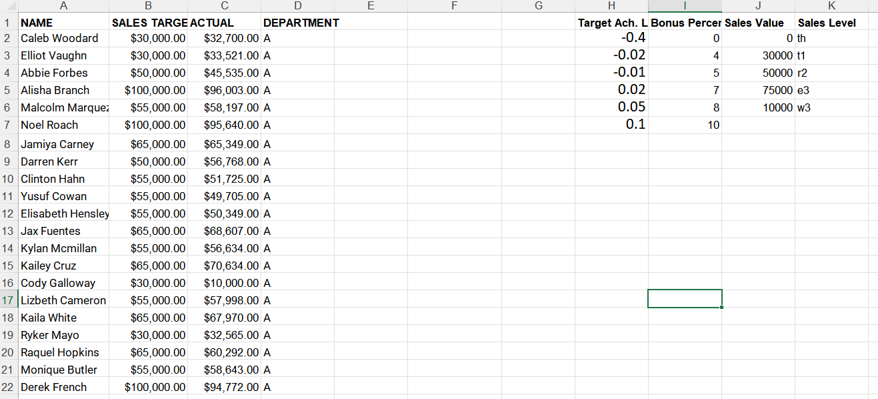
Task 3 - Data Manipulation
Smitha Chundakkad
Dataset 1
Which of the sale teams had the best sales result? Which sales person performed the best and who performed the worst?
This is a fake dataset provided by Cambridge Spark for learning purposes. It contains the names of employees in a company from four departments, their sales target and actual sales.
Objective
My objective was to find the best and worst performer based on their target achievement level and calculate the average performance of the overall sales team.

Slide 14
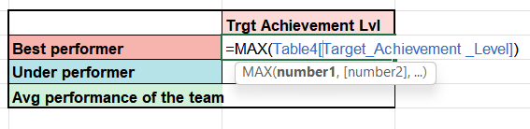
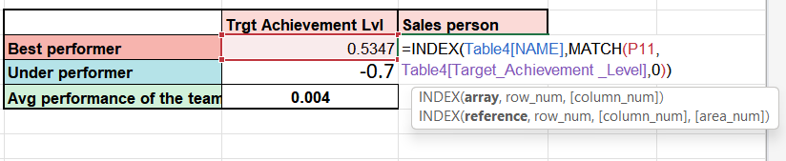
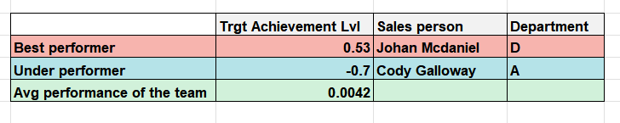
Task 3 - Data manipulation
Smitha Chundakkad
Evidence
I created a new column to calculate the target achievement level for each employee.
I then used the MAX and MIN functions to find the Target Achievement levels of the best performer and the under performer.
Using the INDEXMATCH function I found the names of the best and the under performers.
I found the Average performance of the team using the AVERAGE function.
Result
The best performer is Johan McDaniel from Department D.
The worst performer is Cody Galloway from Department A.
The average performance of the overall sales team based on their Target achievement level is 0.0042.

Slide 15
Task 3 - Data manipulation
Smitha Chundakkad
Action
I calculated the bonus percentage for each sales agent and the total bonus based on the target achievement level using the VLOOKUP function.
I then used ‘Colour scales’ in ‘Conditional Formatting’ to visually highlight the percentage bonus levels of each sales person.

Slide 16
Task 3 - Data manipulation
Smitha Chundakkad
Action
I used a pivot table to calculate the Total and the Average total sales, Total sales target, Average sales Target and the Average Target achievement Level per Department.
PIVOT TABLE

Slide 17
Task 3 - Data manipulation
Smitha Chundakkad
Result
Based on the Average Target Achievement level, Department D performed the best and C performed the lowest.
But, when we look at the average performance of each sales person, Department B performed the best with 13 agents, while D performed second with 47 agents. This make us think that whether the comparison was a fair one.
Conclusion
Working with some basic calculations and functions helped to summarise the data to help with better understanding of the overall picture. Use of Pivot Tables and VLOOKUP made the process quicker. Conditional formatting gave the data an easy visual interpretation of the performance of each sales agent.

Slide 18

Task 3 - Data manipulation
Smitha Chundakkad
Dataset 2
The relationships between blood pressure, blood sugar and cholesterol and heart disease
This project is based on real world datasets that are publicly available. I am using a data set related to heart disease. The directory contains 4 databases concerning heart disease diagnosis, collected from four locations.
Heart disease data set on UCI Repository
Objective
My objective is to combine the datasets from these different countries to investigate the relationship between blood pressure, blood sugar, cholesterol and the existence of a heart disease, and to investigate if these findings will be different in different countries.

Slide 19
Task 3 - Data manipulation
Smitha Chundakkad
Action
I extracted the data using Power Query and did some data cleaning by removing empty rows, formatting dates and changing the ‘gender’ column to male and female instead of numerical values. After loading it to Excel, I changed some of the headers so that its easy to understand.
I calculated the average age of the patients and plotted a histogram.
Then I calculated which month the most samples were received.

Slide 20
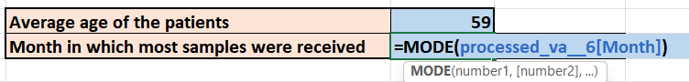
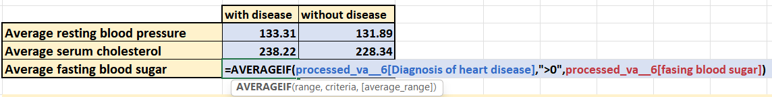
Task 3 - Data manipulation
Smitha Chundakkad
Exploration of data on this page is for the data collected from VA Medical centre, CA
Result
From these calculations and graphical representations we can see that among the patients tested in The VA medical Centre, the most number of patients fall between 59 and 62 years of age. The graph shows normal distribution.

Slide 21
Task 3 - Data manipulation
Smitha Chundakkad
Result
From the above graphs we can conclude that the average resting blood pressure, serum cholesterol and fasting blood sugar of patients with heart disease is higher than those without heart disease.

Slide 22
Task 3 - Data manipulation
Smitha Chundakkad
Is there a relationship between the sex of the patients and the existence of heart disease in the data from different countries?
Result
When analysing heart disease in relation to gender in different countries, we can conclude that in the 4 different countries, out of all the patients tested, there were more men than women with heart diseases.

Slide 23
Task 3 - Data manipulation
Smitha Chundakkad
Objective
To find if there is a relationship between age and heart disease.
Action
I created a ‘Pivot table’ with the age and the number of patients.
I chose a ‘bin’ of 5 years for the age range.
Plotted the data with a ‘Pivot chart’
True= heart disease False= no heart disease

Slide 24
Smitha Chundakkad
Task 3 - Data manipulation
Result
Data from different countries shows that the most number of patients are between the ages of 50 and 60. The graphs show normal distribution. In Switzerland and VA, out of the patients tested, there were more with heart disease than not. But, in Hungary most were without heart disease than patients with heart disease.
Conclusion
By performing this task, I learned how to use various charts, like bar chart, pie chart and clustered column chart. I also used different bins for the ages and was able to plot using them. The visualisation helped me with the analysis of the data from different countries at the same time.

Slide 25
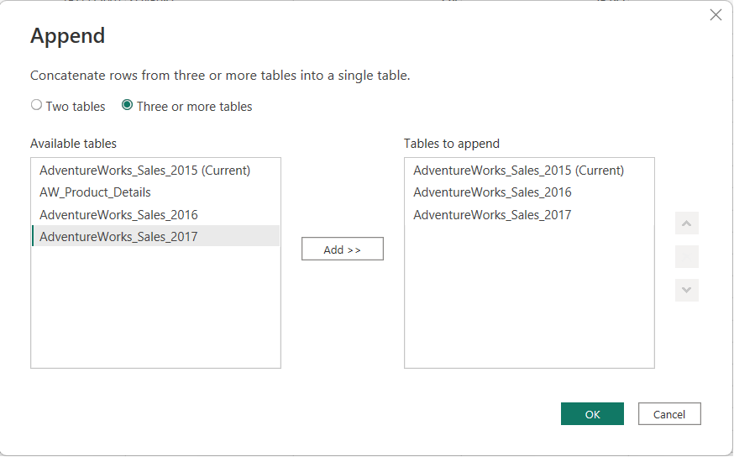
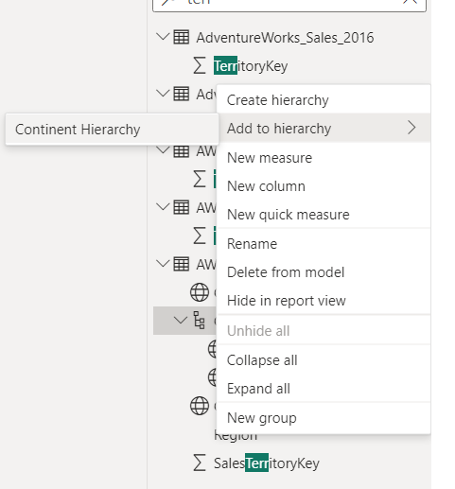
Task 4 - Data visualisation with Power BI
Smitha Chundakkad
To use data visualisation tools to represent data graphically, highlighting patterns and trends in data and helping the reader to achieve quick insights.
Creating Hierarchies to show multiple levels of details.
Objective
The task is to design and deliver an interactive dashboard in Power BI to track some key performance indicators (KPIs). The dataset is for a fictional company, Adventure Works Cycles, given by Cambridge Spark for learning purposes.
Appending Queries to add more data to existing Query

Slide 26
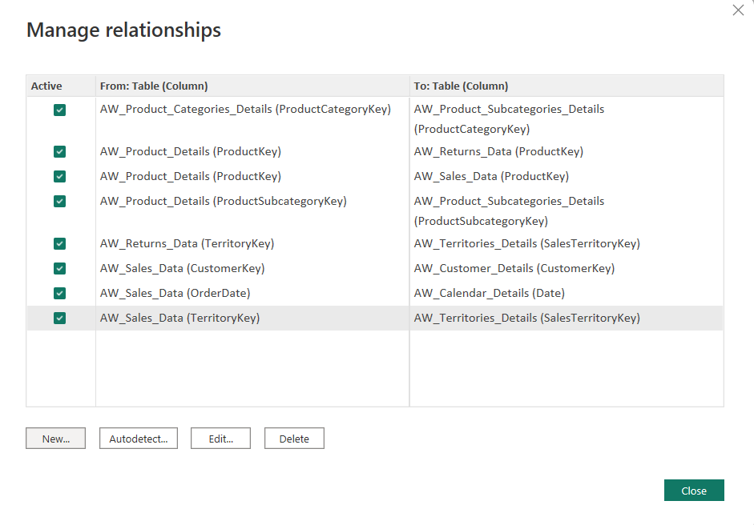
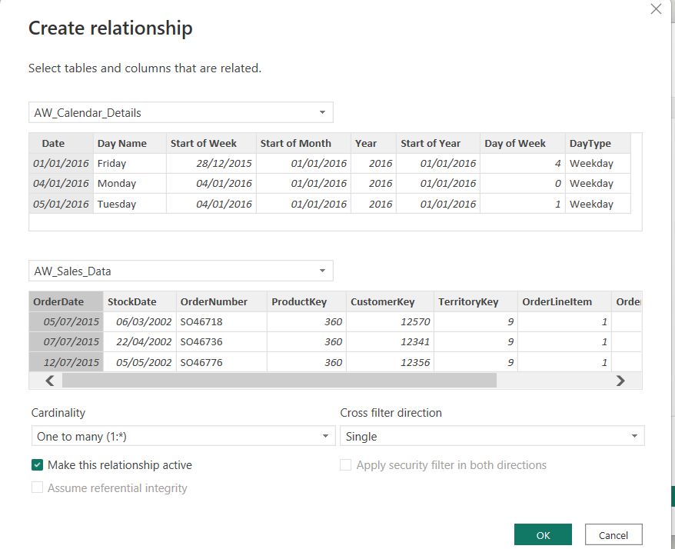
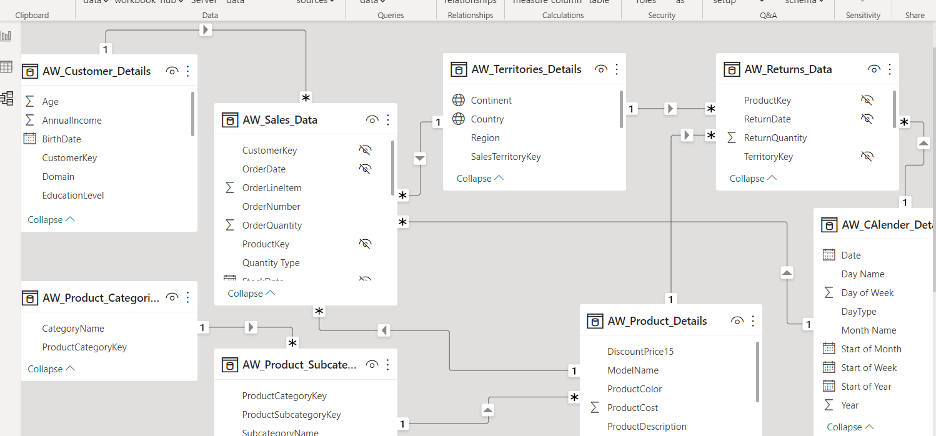
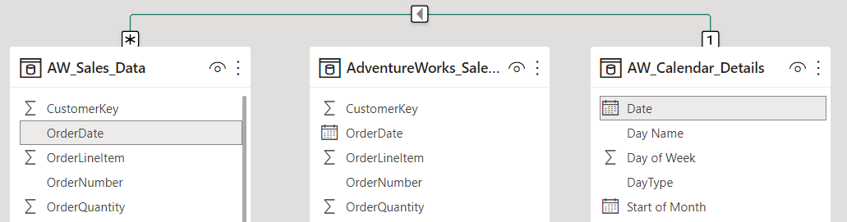
Task 4 - Data visualisation with Power BI
Smitha Chundakkad
Evidence
Creating Relationships
Managing Relationships
Data model

Slide 27
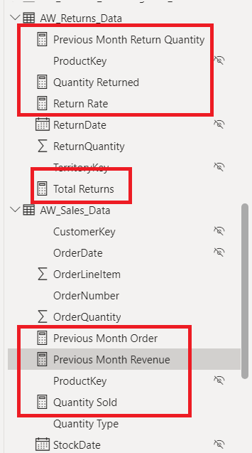
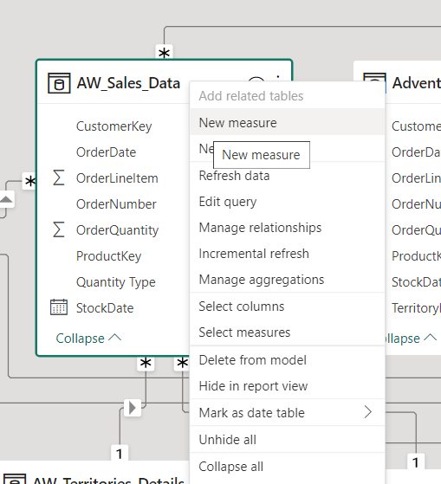
Task 4 - Data visualisation with Power BI
Calculations using DAX measures
Evidence
Explicit measures can be used anywhere in the report, and referenced within other DAX calculations

Slide 28
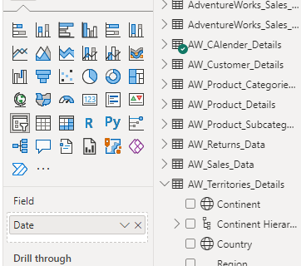

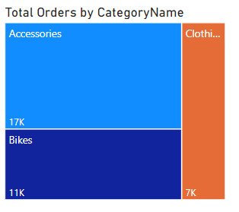
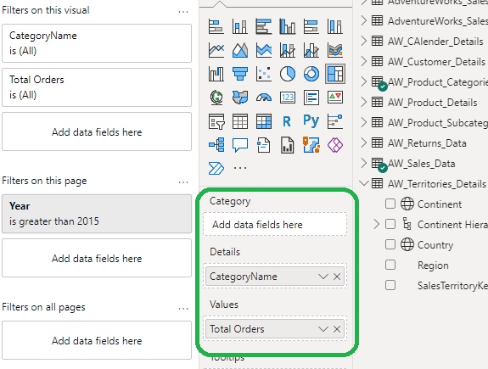
Task 4 - Data visualisation with Power BI
Smitha Chundakkad
Action
Load and transform data
Build relationships between tables to create a data model
Design and build interactive reports
A Slider are used to apply time-based filters to the sales data. We can use the relative date slicer to show only sales data that’s happened within a given time frame.
A TreeMap is used to display Total orders by Category name. It is a way of visualising each category in proportion to the quantity.

Slide 29
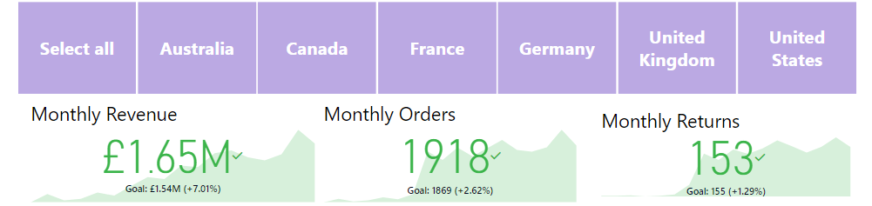
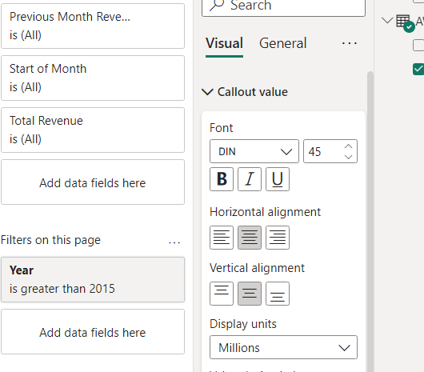
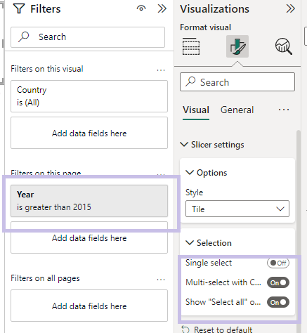
Task 4 - Data visualisation- Power BI
Smitha Chundakkad
A country filter is used to filter the data by country. By selecting each country we can see the sales details of that country.
KPI cards have been used to visualise the Monthly revenue, Monthly order and Monthly Returns . The green colour signifies positive growth within the company.

Slide 30
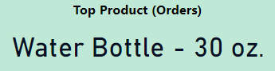
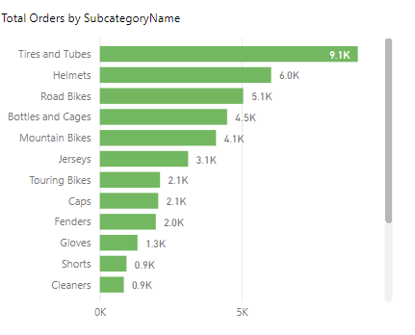
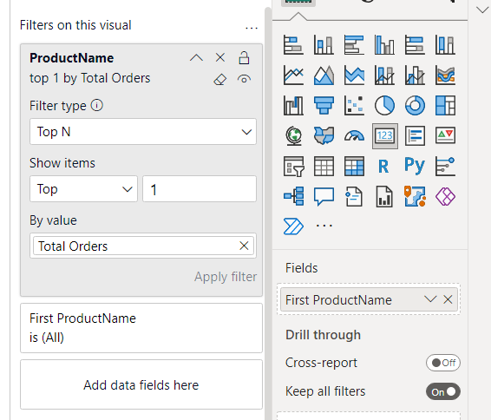
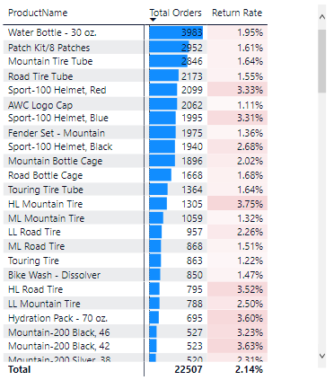
Task 4 - Data visualisation- Power BI
Smitha Chundakkad
A Matrix Table is used to analyse and understand the relationships between data sets. The drill down function is very useful in comparing the data sets.
A Clustered Bar Chart has been used to display the Total order by Subcategory. By this we can make direct comparisons across different subcategory orders.
Using Multi row cards and filters to visualise Top and Bottom Products by Orders and Profits.

Slide 31
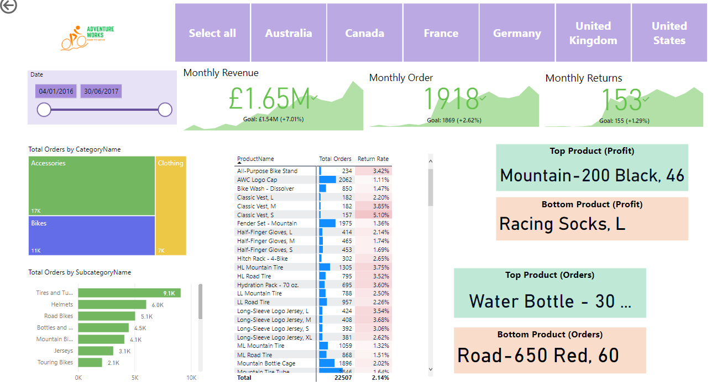
Task 4 - Power BI Dashboard
Smitha Chundakkad
Conclusion
Data visualisation helps to tell stories by curating data into a form easier to understand, highlighting the trends and outliers. By learning to use Power BI, I was able to visualise data and conduct basic analysis.

Slide 32

Outcome-What I learned in the Bootcamp
Smitha Chundakkad
Starting the bootcamp with basic Excel skills, I had minimal knowledge of Data Analysis.
After the fast paced learning of 10 weeks, I can now use Excel to do Data Cleaning, use simple and nested formulas and use complex functions like VLOOKUP and XLOOKUP to do Data Manipulation.
I can use Data Extraction to retrieve data out of data sources for further data processing.
I am equipped with the knowledge of how to efficiently use Pivot tables and charts to make the Analysis simpler and easily readable.
I can also use Power BI Dashboard to visually represent the findings, so that the results are dynamic and easily understandable to any audience of varying technical skills.
I can use these newly attained skills to further my career in the research field or apply for new jobs.

